Slide 1
[Ask the Right Questions to Explore Wisely]
Notes:
Title Slide

Slide 2
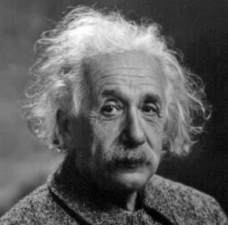
“If I had an hour to solve a problem and my life depended on it, I would use the first 55 minutes determining the proper questions to ask”
Albert Einstein (1879-1955)

Slide 3
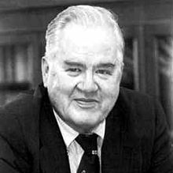
John Tukey (1915-2000)
“Far better an approximate answer to the right question, which is often vague, than the exact answer to the wrong question, which can always be made precise.”

Slide 4
What are the aptitudes and attitudes of Effective Analysts?
Notes:
In-class activity: Have students write down the traits they think effective analysts have. In Few’s reading assignment, he asks the reader to jot down what they think in the margin of the textbook before continuing (see page 19 of Now You See It Reading). Ask students to share and discuss what they wrote in the margin. How do these traits help “ask the right questions”?

Slide 5
Steve Few: Aptitudes and Attitudes
Interested
Curious
Self-motivated
Open-minded
Imaginative
Skeptical
Aware
Methodical
Able to spot patterns
Analytical
Synthetical
Familiar with data
Skilled in data analysis practices
Notes:
Discuss Few’s chapter
How will these aptitudes and attitudes help us ask better questions?
Have students share examples from their experience.

Slide 6
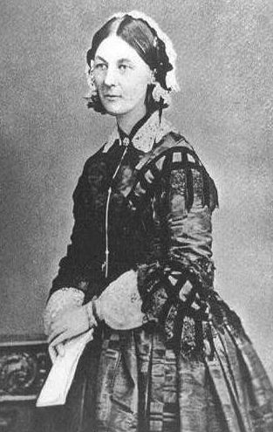
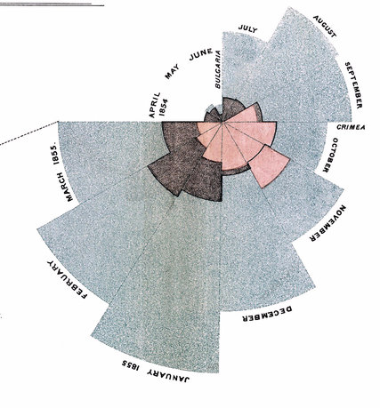

Florence Nightingale (1820-1910) She asked great questions!
Notes:
https://www.sciencemuseum.org.uk/objects-and-stories/florence-nightingale-pioneer-statistician
2020: 200th birthday!
Discuss her work. What important questions did she ask? How did asking those questions help solve a problem?

Slide 7
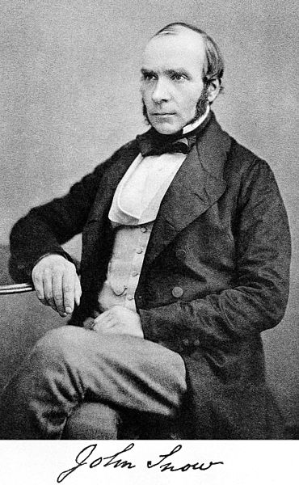
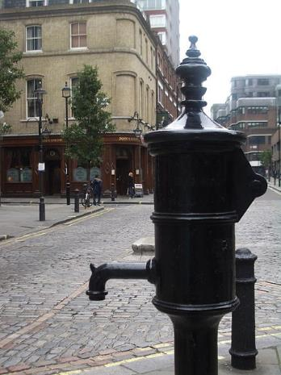
John Snow (1813-1858) Cholera in London
Notes:
MIASMA THEORY
Many in the early to mid-nineteenth century felt that cholera was caused by bad air, arising from decayed organic matter or miasmata. "Miasma" was believed to pass from cases to susceptibles in diseases considered contagious. Believers in the miasma theory stressed eradication of disease through the preventive approach of cleansing and scouring, rather than through the purer scientific approach of microbiology. One prominent supporter of the miasma theory was Dr. William Farr, then assistant commissioner for the 1851 census and a career employee of the government's General Register Office. For a while, Farr was convinced that cholera was transmitted by air. He reasoned that soil at low elevations, especially near the banks of the River Thames, contained much organic matter which produces miasmata. The concentration of such deadly miasmata would be greater at lower elevations than in communities in the surrounding hills. His calculations in 1852 seemed to support this theory (click here for a 1961 redrawing of Farr's 1852 calculations).
GERM THEORY
The alternative theory, supported by John Snow, held that cholera was caused by a germ cell, not yet identified. He reasoned that this germ was transmitted from one person to another by drinking water. Snow's germ theory was deemed "peculiar" by John Simon, head medical officer of London, but has since met the test of time. What was this peculiar theory?
http://www.ph.ucla.edu/epi/snow/choleratheories.html

Slide 8
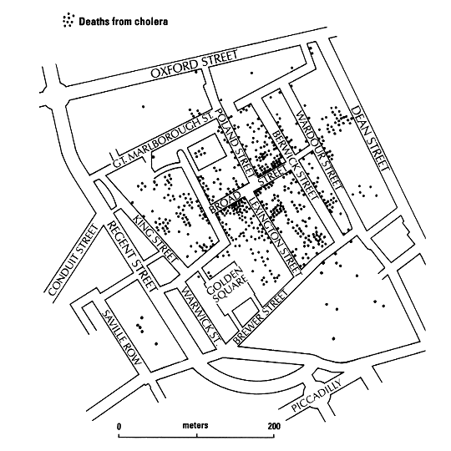
Cholera Deaths
Notes:
https://www.ph.ucla.edu/epi/snow/snowcricketarticle.html
To test his idea that cholera was contracted through contact with germs in water, rather than bad air:
Snow received data on deaths attributed to cholera from man named William Farr, who was at the time London’s Registrar-General.
He plotted the deaths on a map of the city……

Slide 9
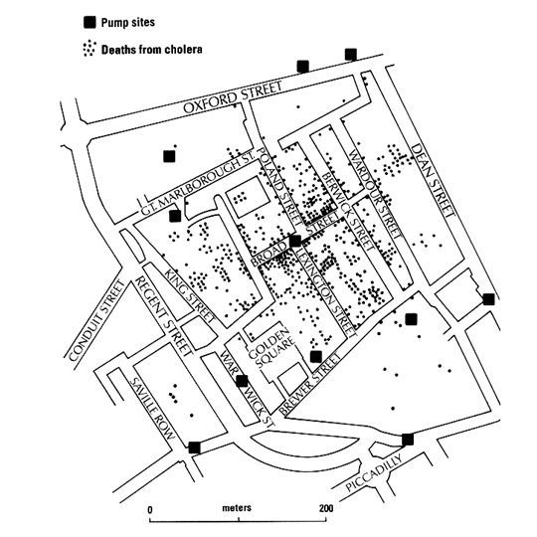
Cholera Deaths & H₂O Pumps
Notes:
https://www.ph.ucla.edu/epi/snow/snowcricketarticle.html
Then plotted the locations of the cities water pumps which supply water to the city.
After a little more research, he determined that the cases had some contact with water from the Broad St. pump.
The story of John Snow is important, because it gives an example of solving a health problem through statistical methods, without knowledge of the underlying biological “cause” of the disease. He did not know what the specific biological properties of the “germ” was, but he was successfully able to discover the source of the problem.

Slide 10
Mental Model of data analysis
1. The raw data come in
2. Format suitable for analysis
3. Then you conduct exploratory data analysis (EDA)
4. Once EDA is complete you can go to modeling the data (if necessary)
5. Once modeling and EDA is done, we can produce results
6. The results are then communicated
Notes:
Discuss Chapter 2 of Essays of data analysis

Slide 11
Mental Model Missing Key Aspects
Context
Resources
Audience
Notes:
Discuss Chapter 2 of Essays of data analysis
Have students discuss how Nightingale and Snow considered context, resources and audience in their analyses and communications.

Slide 12
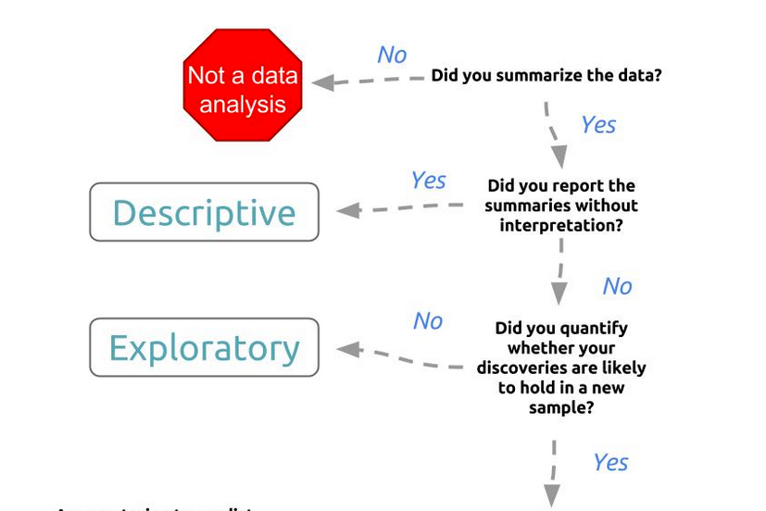
The Data Analytic Question
Notes:
Refer to Elements of Data Style to discuss each term (definitions included in reading)

Slide 13
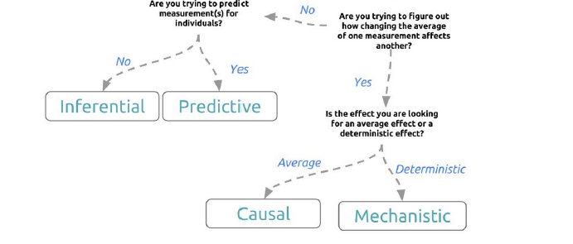
The Data Analytic Question
Notes:
Refer to Elements of Data Style to discuss each term

Slide 14
In Class Activity: Begin Question Assignment
Consider questions about topics that you are passionate about.
Search internet for articles describing data analyses that address your question.
Critique an article by applying the concepts covered in our readings.
Notes:
Students work individually, in pairs or in small groups, and in large class discussion.
This activity can be an opportunity to review how to find reputable sources and begin homework assignment.
Instructor option: Narrow the exercise to your field of study.

Slide 15
Notes:
Tableau Logo

